Slide 1
New Car Dealer Showroom New York

Slide 2
1. Introduction
Locations for New Car Dealer with Showroom in New York
The insights derived from analysis will give good understanding of the business environment which help in strategically targeting the market and the best location for a new Showroom for a multi-brand of green car. The offer will be more than just a Toyota Prius hybrid. the show room will offer an entries stock of Mercedes-Benz, BMW, Porsche, and other high-end marques include hybrids, diesels, and unexpectedly high gas mileage.
Qualitative data collected from previous studies, strongly suggests that the best places are in fact areas that are near Vegans Restaurant, Cafés and Wine Bars. Social, healthy people with highly concern about efficiency and environment frequent this place often, so opening new showroom near them is a smart decision.

Slide 3
2. Data
Data 1: Neighborhood has a total of 5 boroughs and 306 neighborhoods. In order to segment the neighborhoods and explore them, we will essentially need a dataset that contains the 5 boroughs and the neighborhoods that exist in each borough as well as the the latitude and logitude coordinates of each neighborhood.
This dataset exists for free on the web. Link to the dataset is: https://geo.nyu.edu/catalog/nyu_2451_34572
Data 2: New York city geographical coordinates data will be utlized as input for the Foursquare API, that will be leveraged to provision venues information for each neighborhood. We will use the Foursquare API to explore neighborhoods in New York City and restaurant, cafe and wine bars locations inside each neighborhood to select the one to propose to the company.

Slide 4
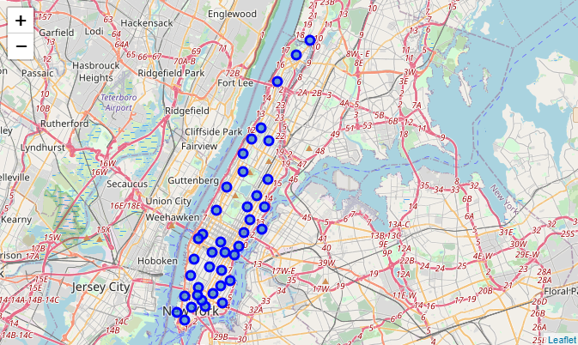
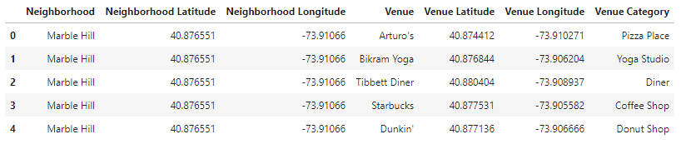
3. Exploratory Data Analysis
Manhattan city Geographical Coordinates Data
By filtering the data selecting Manhattan only we remain with a total of 39 neighborhoods.
Manhattan is the preferred location
Venues location and categories from Foursquare

Slide 5
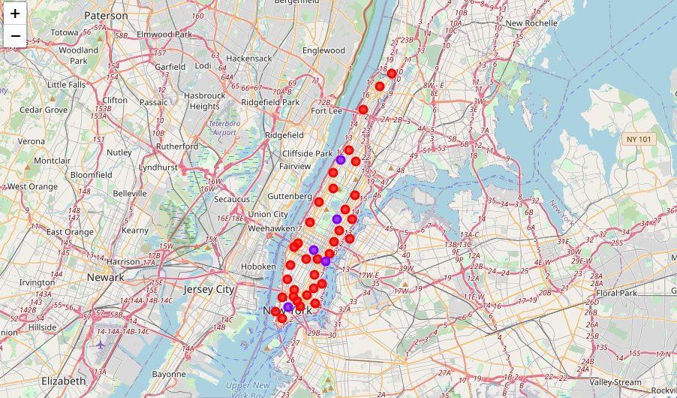
3. Exploratory Data Analysis
Different types of clusters created by using K-Means Manhattan.
Cluster 0: The Total and Total Sum of cluster0 has smallest value. It shows that in this neighborhood the number of selected venues is lower.
Cluster 1: The Total and Total Sum of cluster1 has highest value. Number of restaurants are very high.

Slide 6
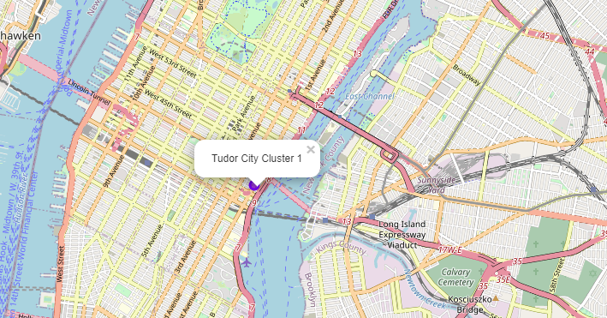
4. Conclusion
Using the success criteria that the best places to open New Car Dealer selling green cars are in fact areas that are near Vegans Restaurant, Cafés and Wine Bars. Social, healthy people with highly concern about efficiency and environment frequent this place often, so opening new showroom near them is a smart decision.
The recommendation is to select a location in Tudor City.

